Slide 1
Mission Analytics Data Exercise
Andrew Han

Slide 2
Exercise Questions
Using the data provided, create a series of visualizations (e.g., charts, graphs, etc.) that answer the following questions regarding the results of the 2006 Pike’s Peak 10k Race:
1. What are the mean, median, mode, and range of the race results for all racers by gender?
2. Analyze the difference between gun and net time race results.
3. How much time separates Chris Doe from the top 10 percentile of racers of the same division?
4. Compare the race results of each division.

Slide 3
Tools and Resources
Analysis done using Python (3 hours)
Google Slides (0.5 hours)
Code, Exercise, Graphs available on Github: https://github.com/DrewHanSolo/MarathonAnalysis

Slide 4
Presuppositions and Disclaimers
In the interest of time...
Runners that have misentered data are ignored. No attempts made to correct data
Time durations are presented in seconds
Runners with a Net Time < 500 secs ignored for most of analysis
No unit tests performed on analysis code
More analysis information available in Analysis.out and Parser.out

Slide 5
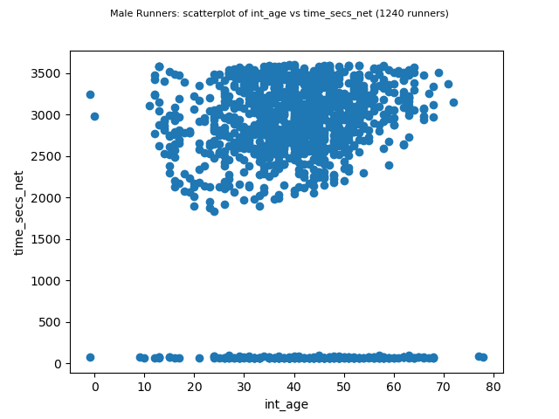
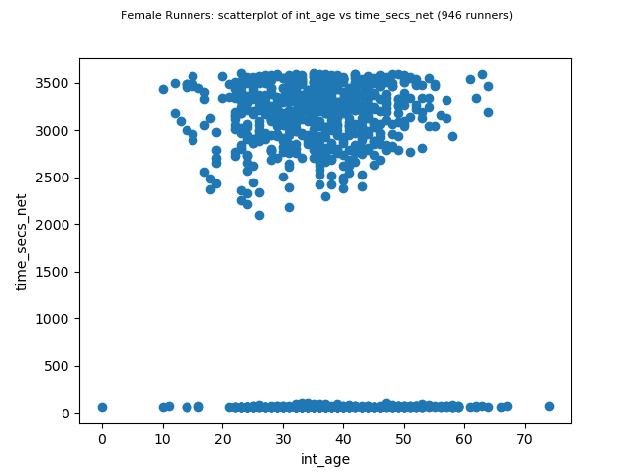
Raw Data (valid runners)

Slide 6
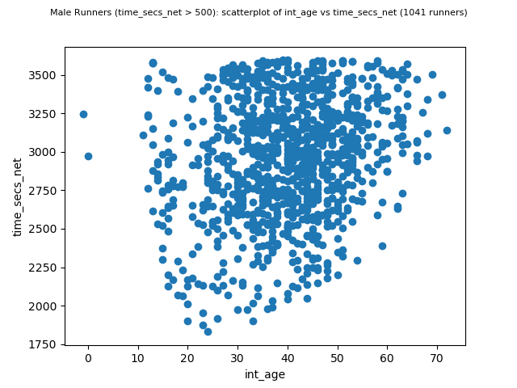
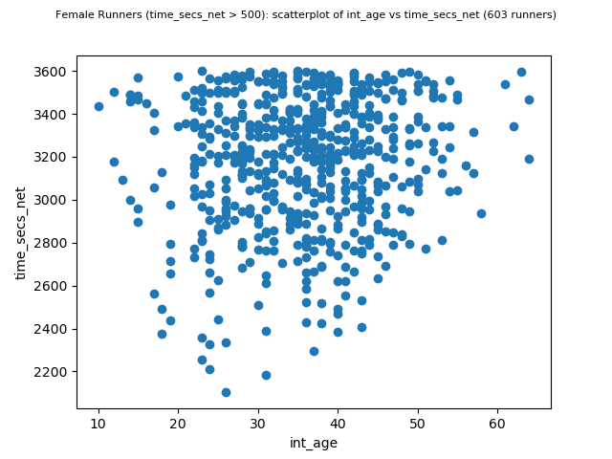
Raw Data (valid runners, NetSecs>500)

Slide 7
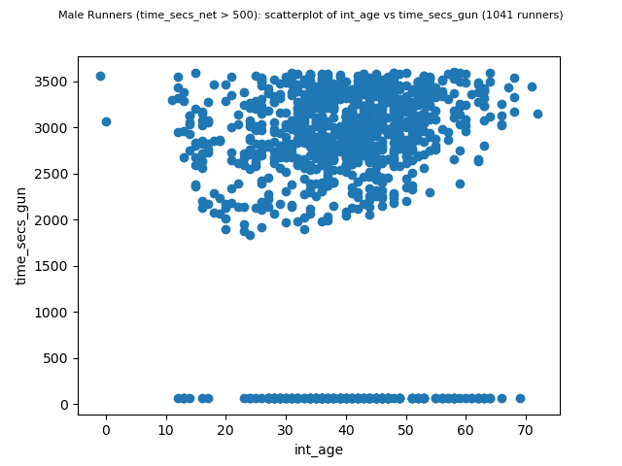
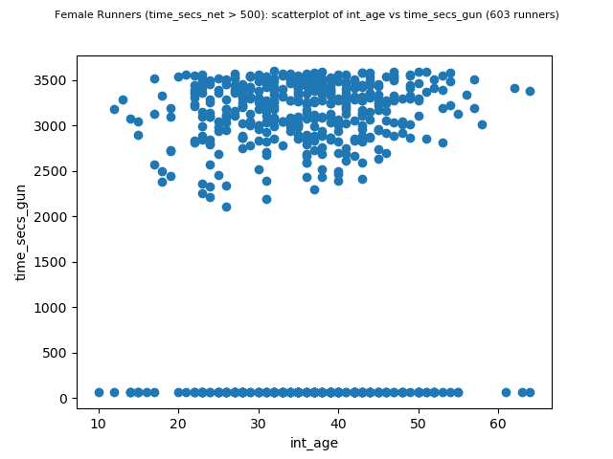
Raw Data (valid runners, NetSecs>500)
Even filtering erroneous NetSecs<500 runners, GunSecs<500 still present.

Slide 8
2. Analyze the difference between gun and net time race results.
Given the erroneous inputs of NetSecs and GunSecs, the difference between values does not hold much meaning. No filters on this calculation:
Male Runners: mean_time_secs_net = mean_time_secs_gun + 378.154032 secs
Female Runners mean_time_secs_net = mean_time_secs_gun + 576.133192 secs
Takeaway: Females crossed the start line later than males

Slide 9
1. What are the mean, median, mode, and range of the race results for all racers by gender?
Ignoring runners who dropped out of the race… (Net Time < 500 secs)
Skipping graphical visualization...numbers are pretty close and graph not needed for comparing 2 entries. See slides 5, 6, 7
Male Runners (time_secs_net > 500): |  |  | Female Runners (time_secs_net > 500): |  |  | Female Differences From Male
Attribute = time_secs_net |  |  | Attribute = time_secs_net
Mean | 2962.10951 |  | Mean | 3176.383085 |  | 214.2735745
Standard Dev | 387.778512 |  | Standard Dev | 306.0706909 |  | -81.70782108
Median | 2988 |  | Median | 3226 |  | 238
Mode | 2128 |  | Mode | 2886 |  | 758
Range = [1830, 3597] |  |  | Range = [2102, 3599]
Count = 1041 |  |  | Count = 603

Slide 10
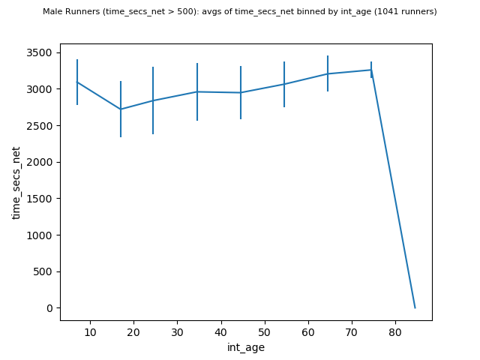
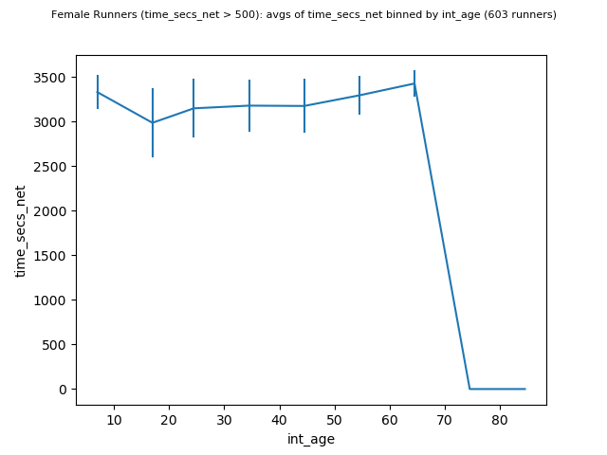
divisions = [[0, 14], [15, 19], [20, 29], [30, 39], [40, 49], [50, 59], [60, 69], [70, 79], [80, 89]]
4. Compare the race results of each division.

Slide 11
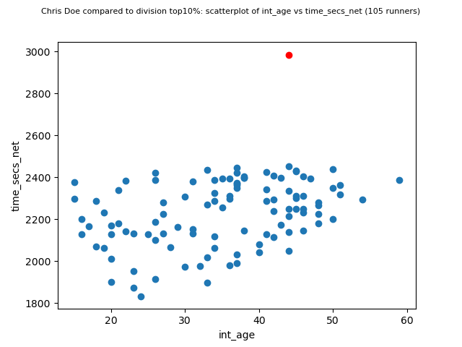
3. How much time separates Chris Doe from the top 10 percentile of racers of the same division?
Net time difference of Chris Doe from top 10% male runners: 754.466667 secs

Slide 12
Future Improvements
Attempt to sanitize misentered data, corroborate entries against each other
Extend analysis code to layer and color code graphs by sex and age divisions
Add unit tests to analysis code
Get a Microsoft Excel license and export raw analysis data to workbook
Reformat log output

